Slide 1



AppBuilder in 45 Minutes
Jen Looper

Slide 2

Jen Looper
Developer Advocate, Telerik
@jenlooper

Slide 3
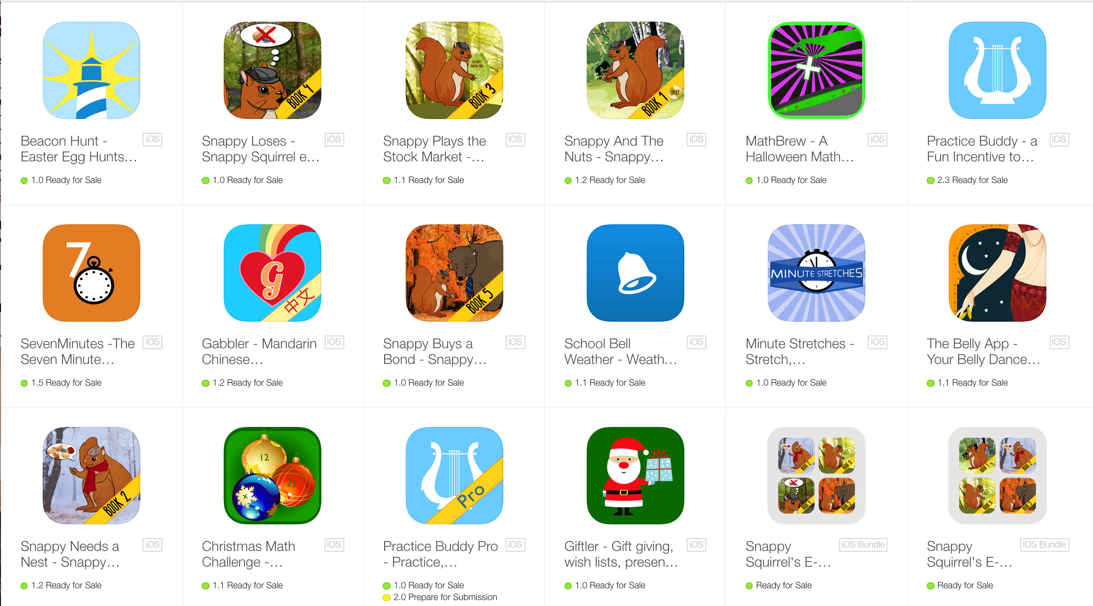
I <3 mobile apps

Slide 4



So, you want to create mobile apps too.

Slide 5

Stop the madness!
Use your web skills to create a cross-platform hybrid mobile app

Slide 6

Treats for everyone!

Slide 7
Telerik AppBuilder can help!
Why you'll love Hybrid
True single Codebase for all platforms
Ease of HTM5/CSS/JavaScript
Access to Native APIs
App Store presence & monetization
Users cannot tell the difference

Slide 8
AppBuilder under the covers
Uses Apache Cordova
JavaScript proxies to native APIs

Slide 9
AppBuilder is…
Cross-Platform Mobile Development, simplified!
Developer freedom!
End-to-End tooling
All the backend services you need

Slide 10

Your Coding Environment – up to you!

Slide 11
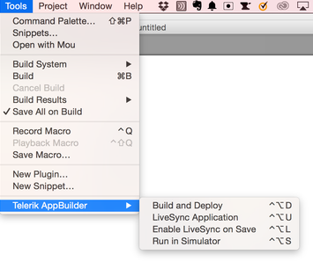
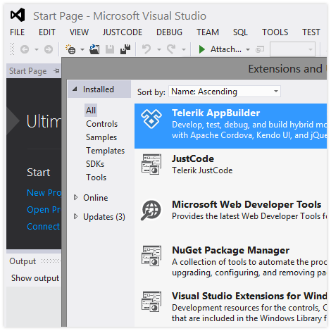
Use your favorite IDE to build
Visual Studio Extension
Sublime Text Plugin

Slide 12
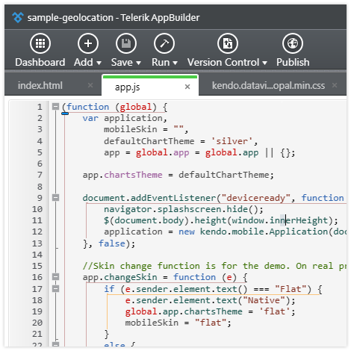
Rich Desktop Options
Windows Desktop Client

Slide 13
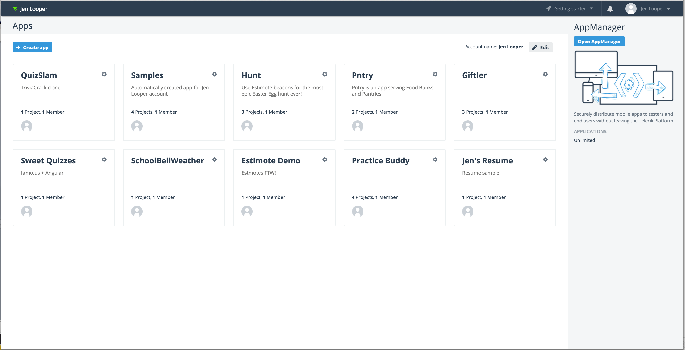
In-Browser client
The Telerik Platform: platform.telerik.com

Slide 14
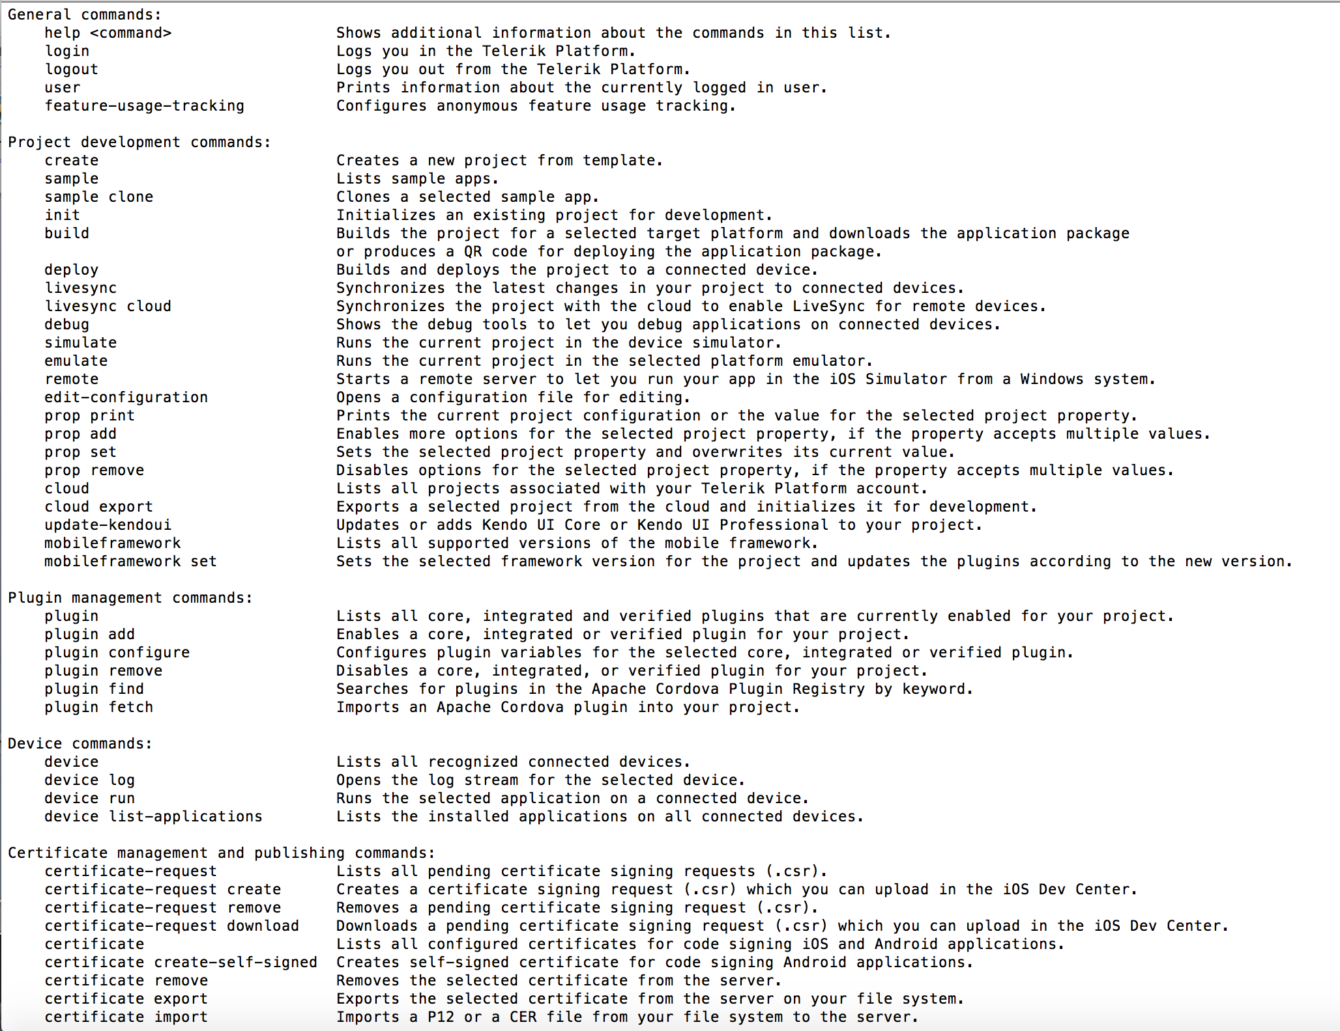
CLI

Slide 15
Create an app using the in-browser AppBuilder Platform in 4 easy steps
1. Create an account at https://platform.telerik.com and sign in

Slide 16
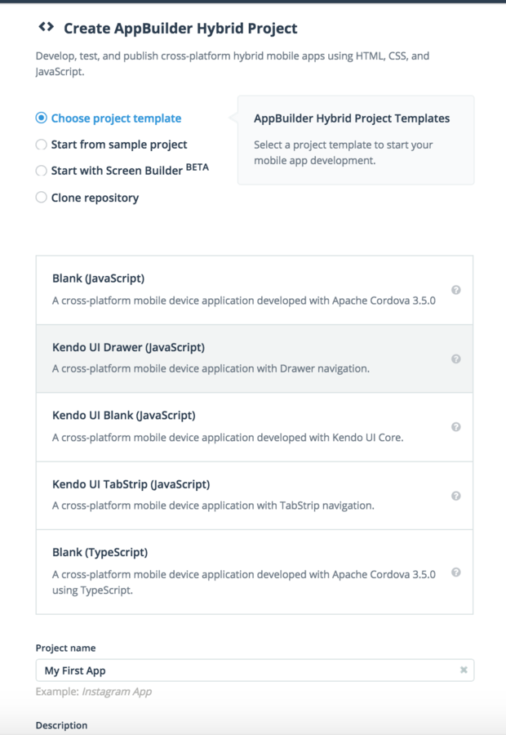
Create an app using the in-browser AppBuilder Platform in 4 easy steps
2. Create an app project

Slide 17
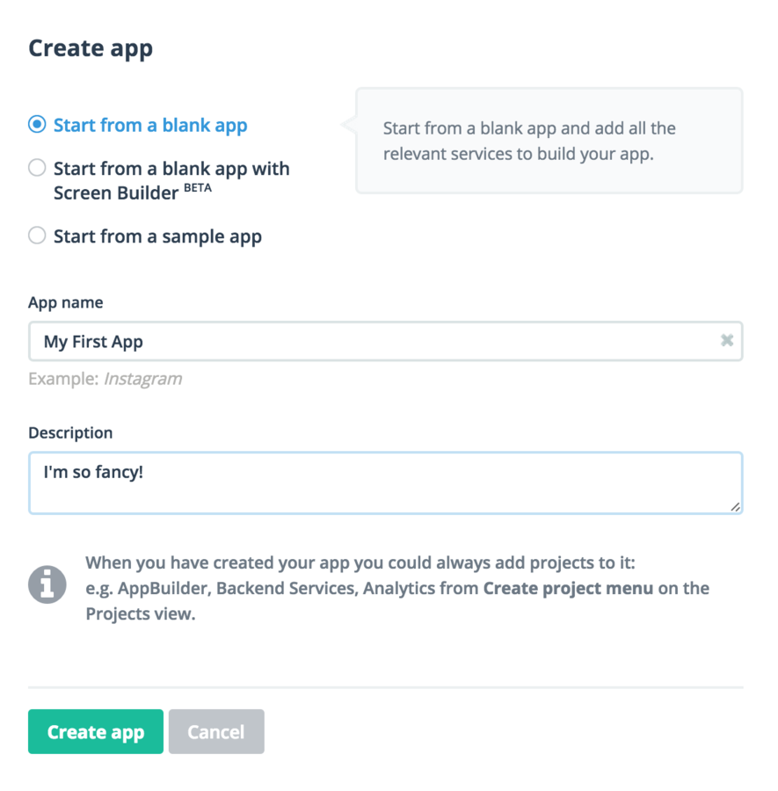
Create an app using the in-browser AppBuilder Platform in 4 easy steps
3. Create a blank app

Slide 18
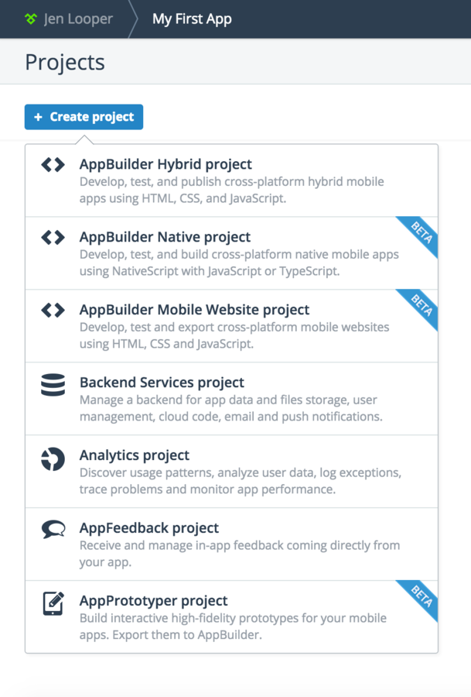
Create an app using the in-browser AppBuilder Platform in 4 easy steps
4. Add elements to your hybrid project

Slide 19
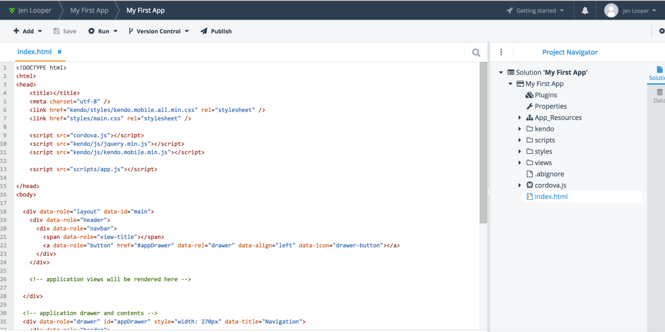
You’re ready to roll!

Slide 20

Let’s come back later to the in-browser experience

Slide 21

A different workflow
Start building your app with the CLI
Push to github
End up in-browser with code pulled from github

Slide 22
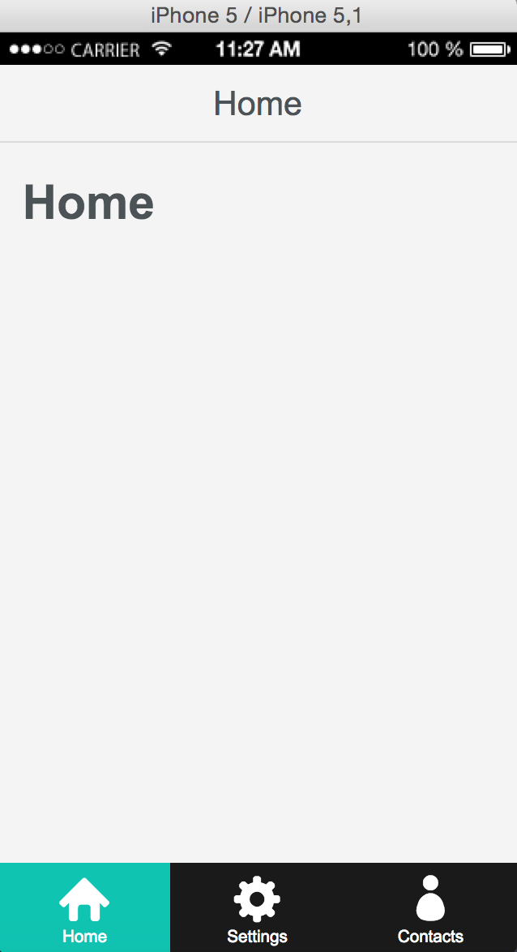
Get started with the AppBuilder CLI
$appbuilder create hybrid MySampleApp --appid com.ladeezfirstmedia.myKendoSample
$cd MySampleApp
$appbuilder simulate
Creates a basic tabstrip app

Slide 23
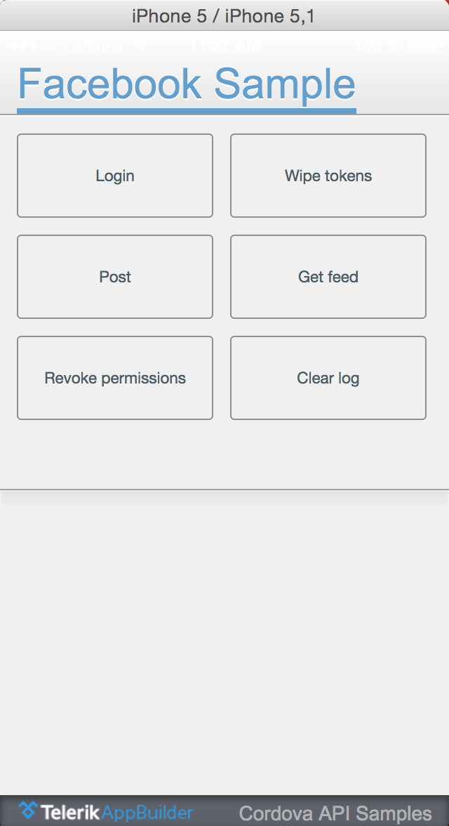
Try sample apps via the CLI
$appbuilder sample clone facebook-api
$cd facebook-api
$appbuilder simulate
Creates a sample facebook-powered app

Slide 24
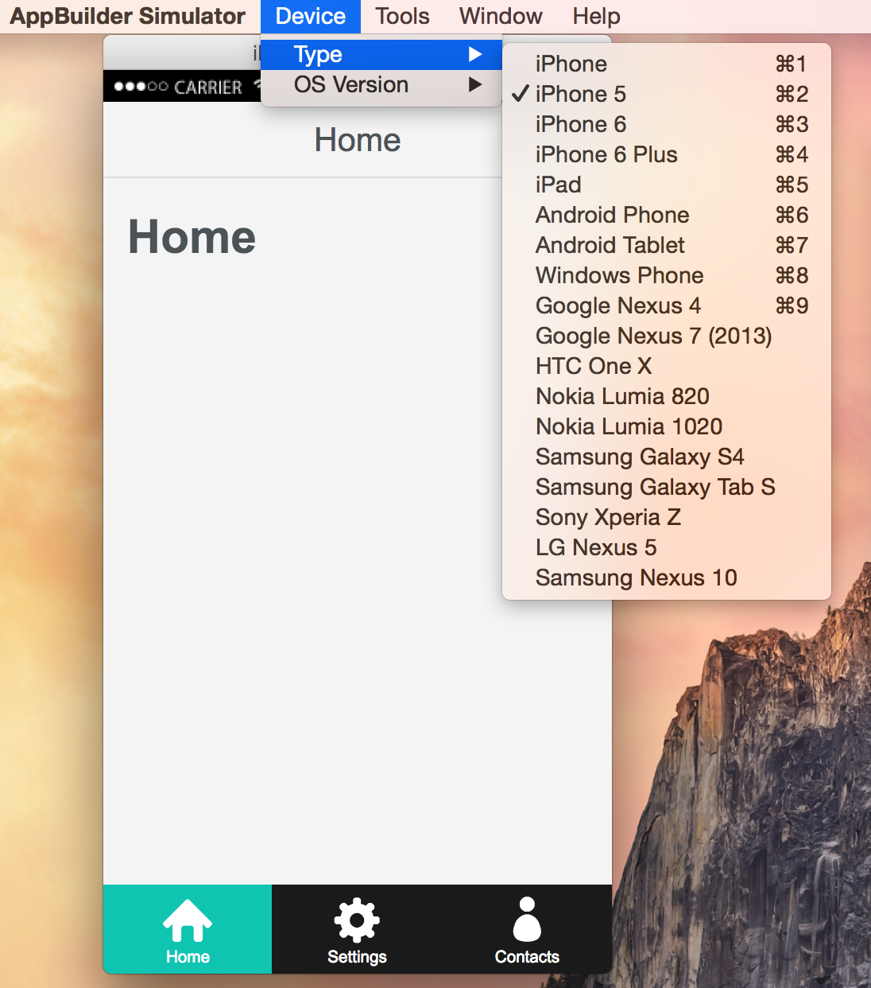
Simulate like crazy
$appbuilder simulate
Check out your app on all kinds of phones and tablets

Slide 25
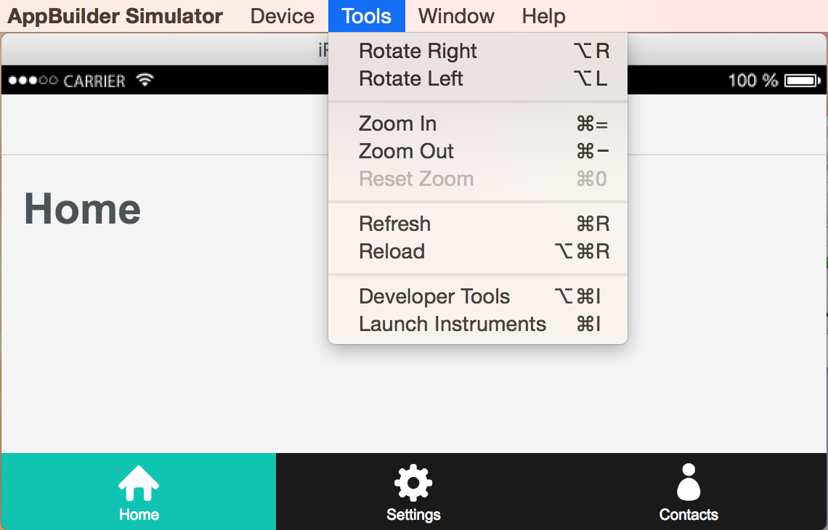
Really nice tooling!
$appbuilder simulate
Ensure responsiveness

Slide 26
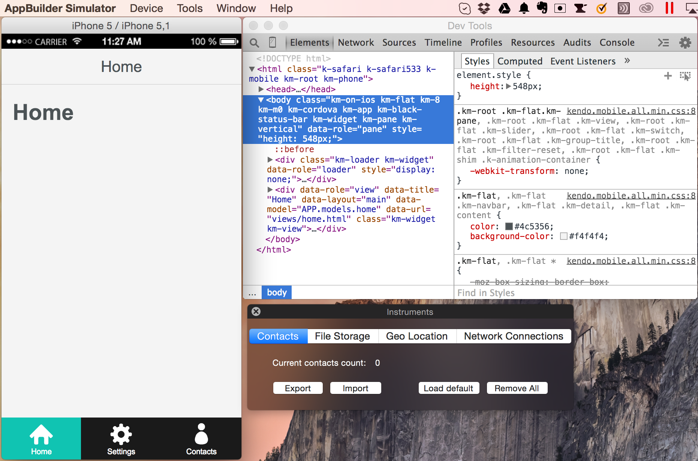
Debug in the browser, track local storage, test connectivity behavior, mock geolocation
$appbuilder simulate
Leverage Chrome devtools – use what you already know!

Slide 27
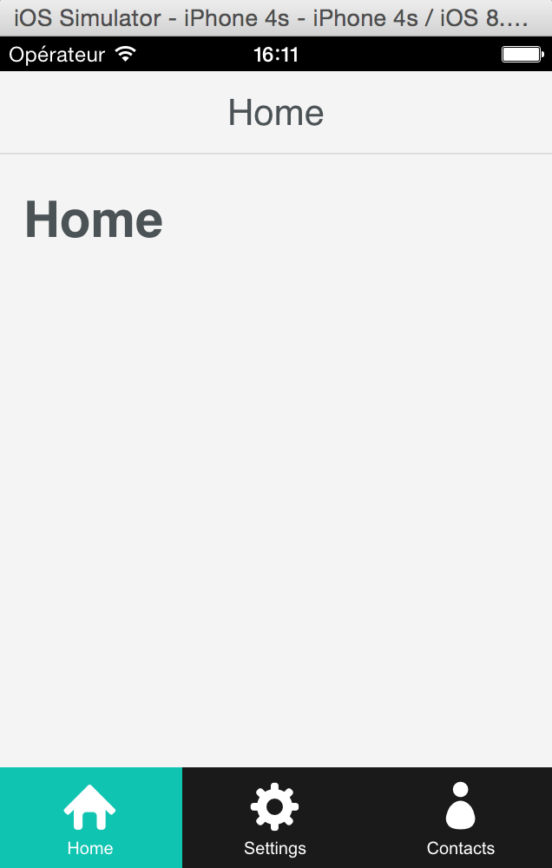
Test your app in a native emulator
$appbuilder emulate ios
Or
$appbuilder emulate android
Or
$appbuilder emulate wp8
Get a closer idea of how your app will behave on various platforms

Slide 28
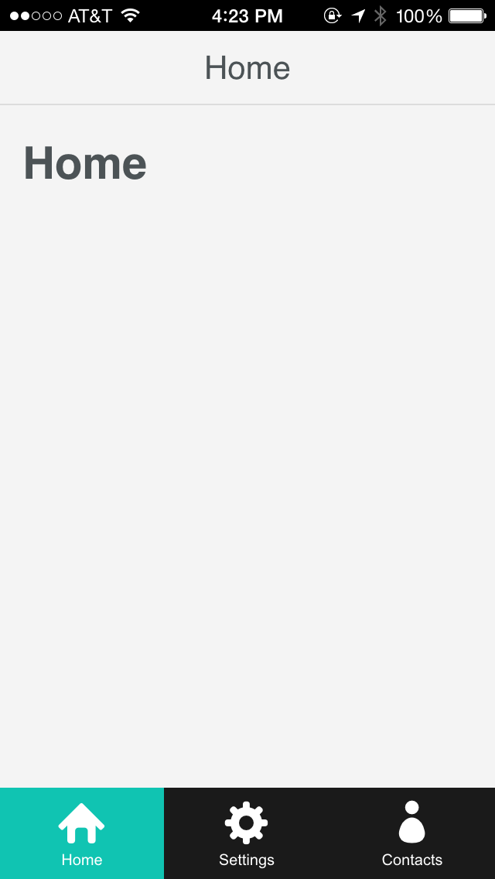
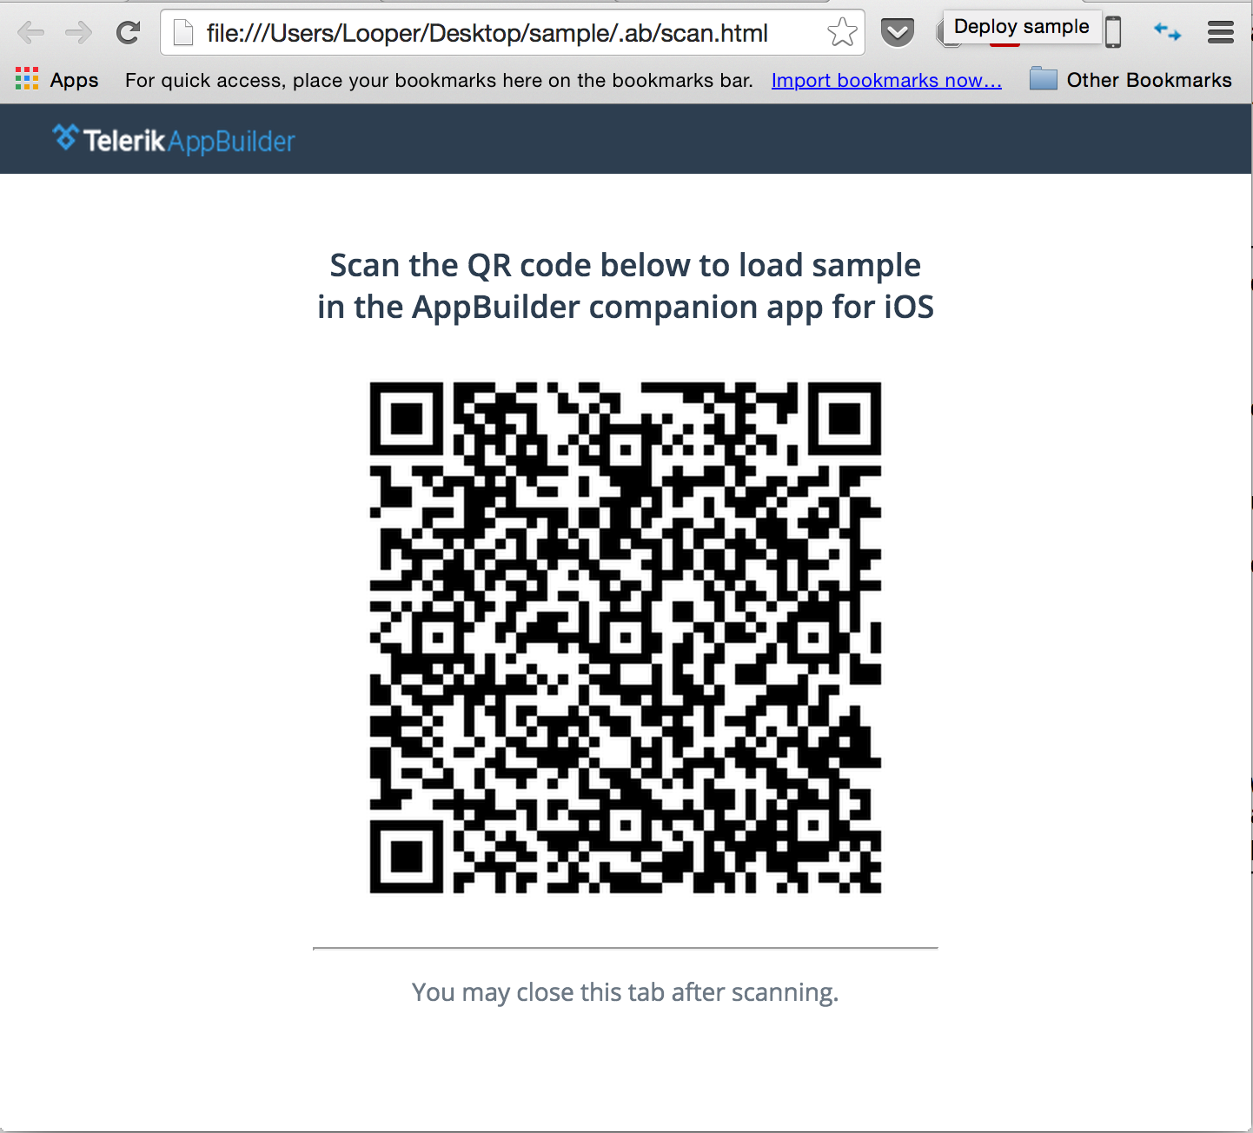
Test your app on device
$appbuilder build ios –companion
Creates a QR code locally for you to test on your phone using the installed Companion App
It’s on my iPhone!

Slide 29
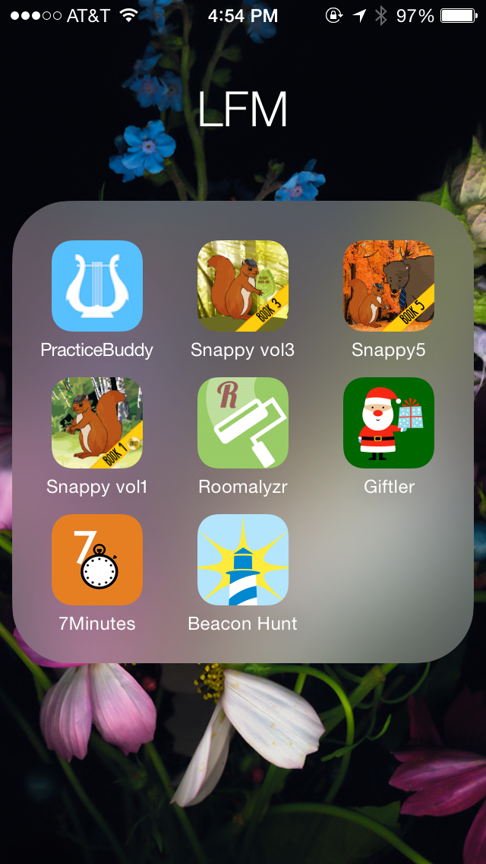
Test outside the companion app
First, get your provisioning sorted out
$appbuilder certificate import
$appbuilder provision import
Then, build for device using your app’s provisioning profile:
$appbuilder build ios –my-apps-provisioning-profile
Apps in progress

Slide 30
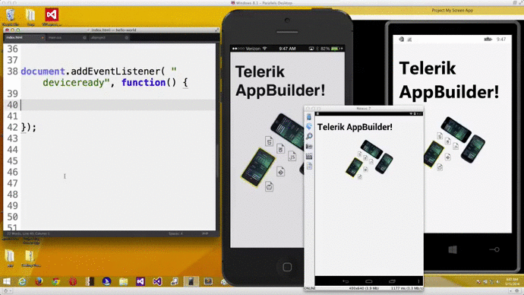

Magic stuff: livesync for fast debugging
Livesync three ways:
On AppBuilder Companion App (3 finger gesture)
On built app on device (same)
In Simulator (automatically!)
Make changes and view quickly
without needing to rebuild

Slide 31
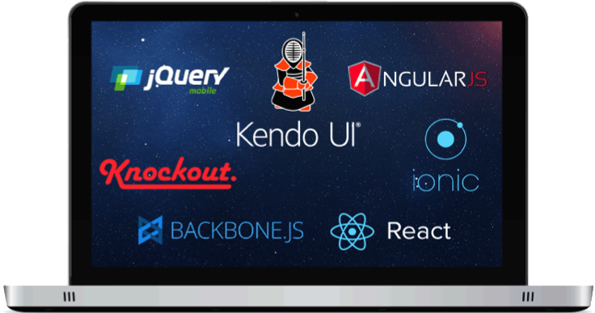
One more thing…
Make apps the way you want.

Slide 32

Let’s get cooking!

Slide 33
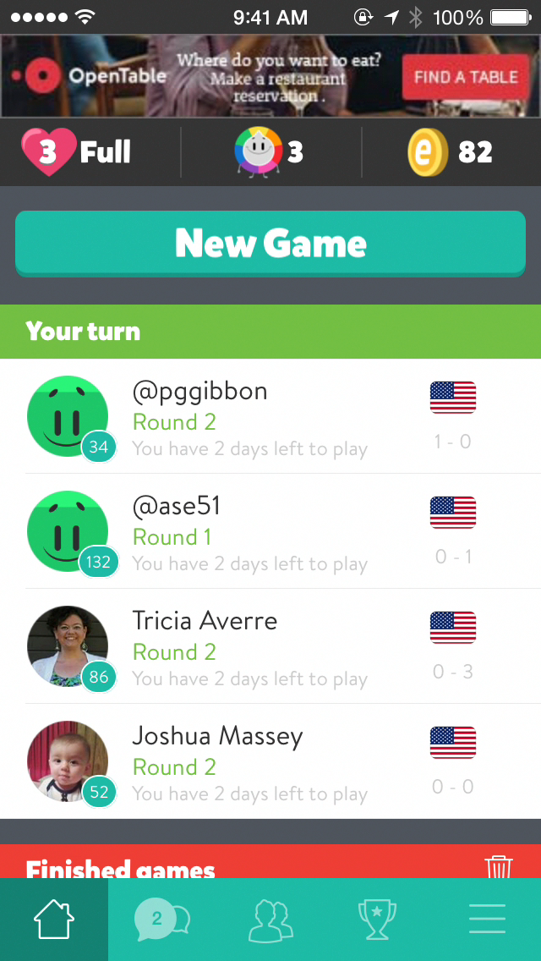
Let’s create a TriviaCrack Clone using Telerik AppBuilder

Slide 34
Requirements for “QuizSlam”:
Integration with content – we’ll use Quizlet
Ability to choose quiz from Quizlet
Game Loop – spin to get random number, show 1 question and 4 possible answers, handle correct/incorrect, scorekeeping
Navigation – 5 sections
Chat (chat button) - TBD
Lists of friends with scores (friends button) - TBD
Saving Scores (scores button) – entails login and backend integration

Slide 35
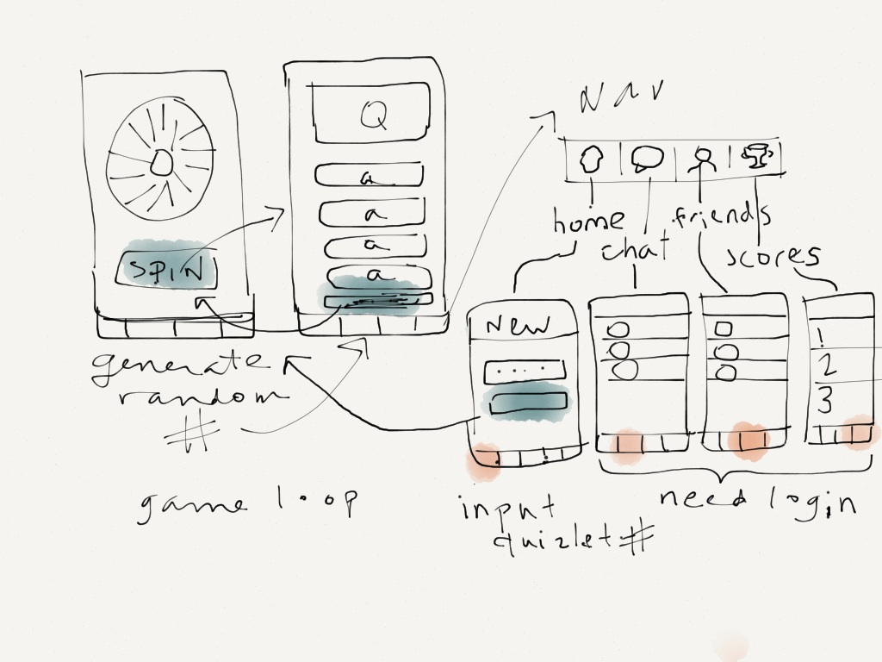
Sketch a GUI:

Slide 36

Disclaimer!
This is just one way to build an app in AppBuilder. Do what works for you!

Slide 37
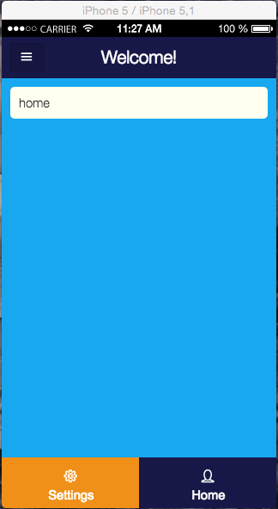
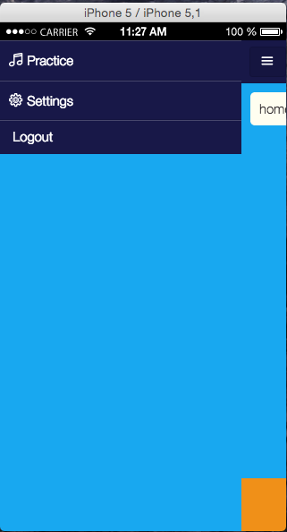
1. Start with the secret sauce!
https://github.com/jlooper/Kendo-Seed
Seed code with:
styles set to my liking
colors ready
fonts installed,
two sample navigation strategies,
optional login code available
modularized code using require.js
Tabstrip navigation
Drawer navigation available

Slide 38
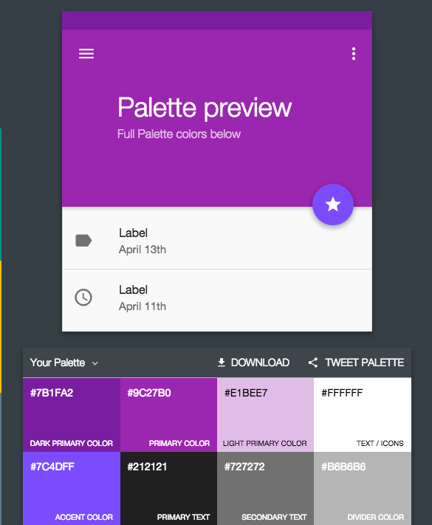
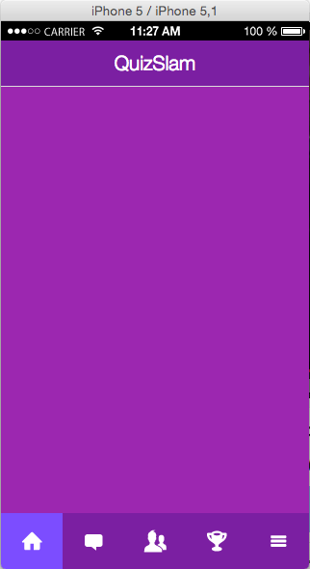
2. Adjust colors and set navigation
MaterialPalettte.com
Tabs
Drawer

Slide 39

Navigation code
<footer data-role="footer">
<div data-role="tabstrip">
<a href="#new"><div class="icon home"></div></a>
<a href="#chat"><div class="icon message"></div></a>
<a href="#friends"><div class="icon users"></div></a>
<a href="#scores"><div class="icon trophy"></div></a>
<a href="#menu" data-rel="drawer"><div class="icon menu"></div></a>
</div>
</div>
</footer>
We’re going to tackle these 2 bits

Slide 40
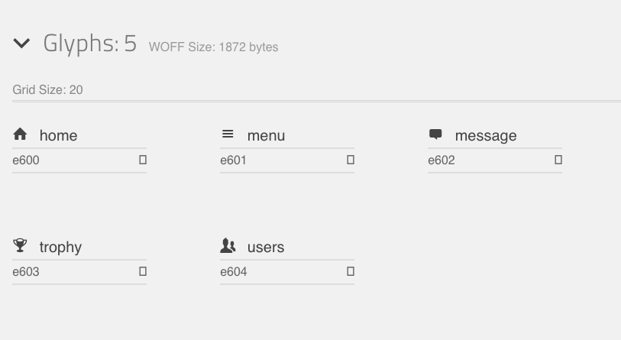
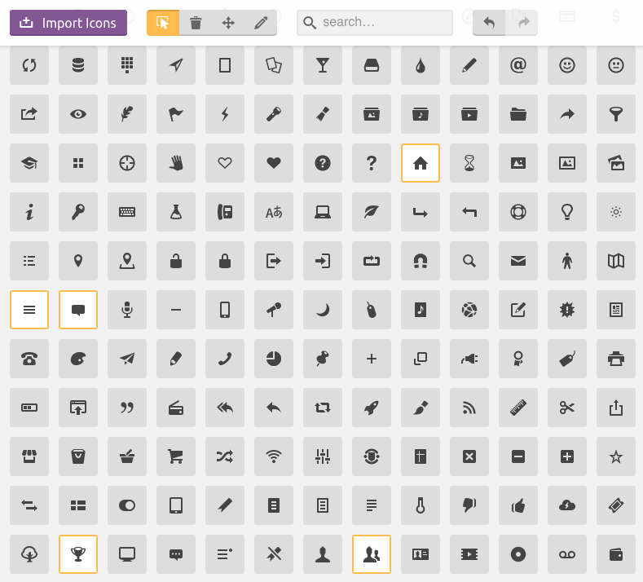
3. Override icons and import .woff files to project
Icomoon.io app

Slide 41
4a. Code structure – index.html
Include require.js
<script src="bower_components/requirejs/require.js" data-main="main.js"></script>

Slide 42
4b. Code structure – main.js
Configure require.js
require.config({
paths: {
'text': 'bower_components/requirejs-text/text'
}
});
define([
'app'
], function (app) {
…
app.init();
}
});

Slide 43
4c. Code structure – app.js
Define required elements
define([
'views/New/New',
'views/Spin/Spin',
'views/Home/Home',
'views/Scores/Scores',
'views/Auth/Auth’
], function () {
var app = window.app = window.app || {};
var init = function () {
app.instance = new kendo.mobile.Application(
document.body,
{ skin: 'flat', loading: "<h1>Please wait...</h1>" }
);
};
return {
init: init
};
});

Slide 44
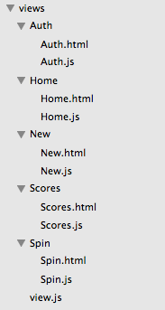
4d. Code structure – views
All views included in /views:

Slide 45
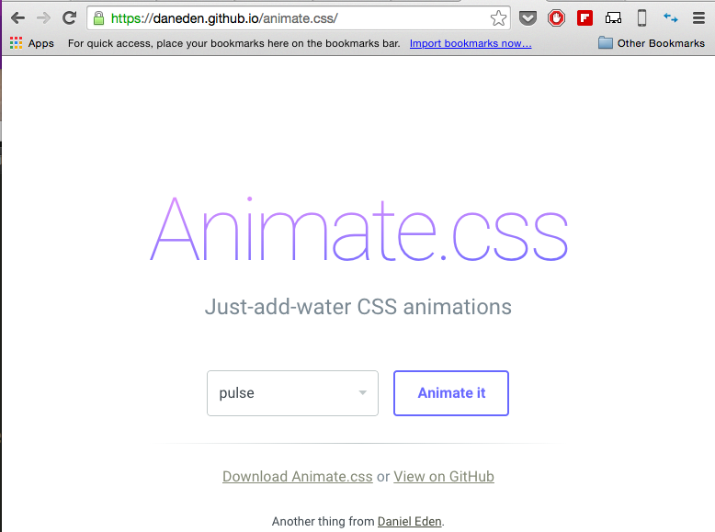
5. Animation
Animate.css CSS Animations FTW

Slide 46
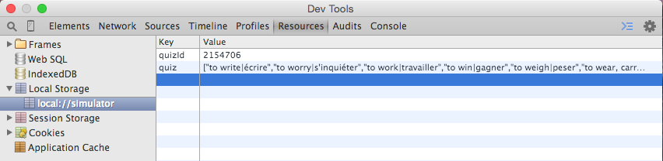
6. Quizlet integration
In New.js (start screen):
set initial quiz id in localStorage
grab content of quiz from Quizlet
parse it into Q/A pairs:
Data!!

Slide 47
7. Game Loop Time!!!
The fun stuff!
Spin wheel
pick a random number from quiz set
show that question and 4 possible answers
handle correct/incorrect.
Correct = allow to spin again, Incorrect = show error, stop from continuing.

Slide 48
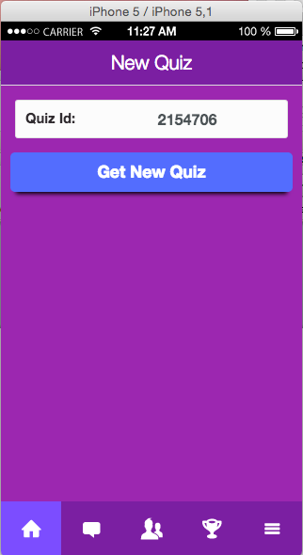
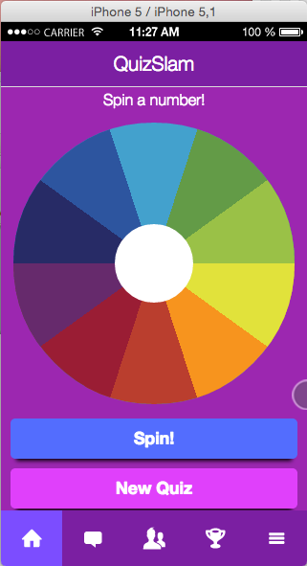
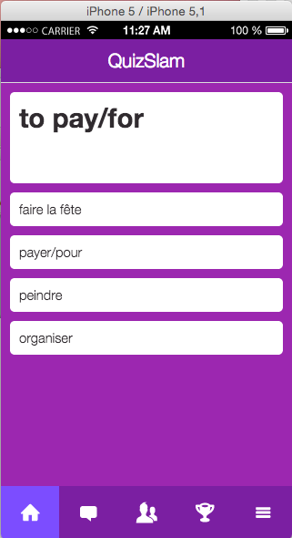
Pick – Spin - Quiz

Slide 49
Demo!

Slide 50
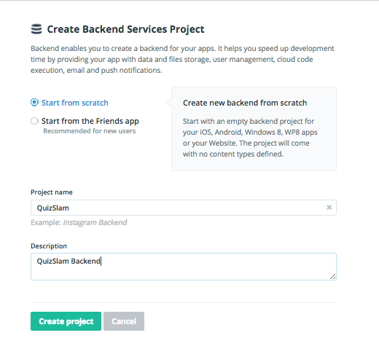
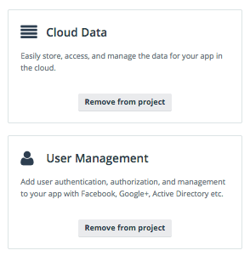
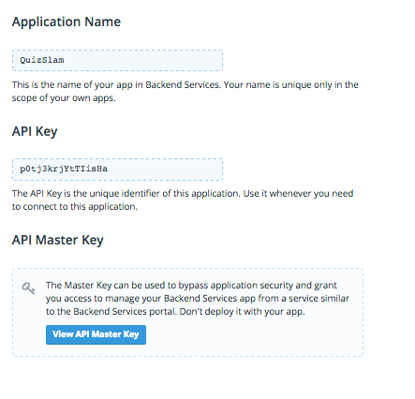
8. Add Backend
1. Add Everlive .min.js to index.html:
<script src="bower_components/everlive/min/everlive.all.min.js"></script>
2. Add Login routine, show forms if token not set, otherwise show scores saved in backend
3. In platform.telerik.com, create a Backend Services project associated to your current project
4. Enable Cloud Services and User Management
5. Grab your Api keys and store them locally
6. Create an account and get a token! Now you’re logged in and can pass data around

Slide 51
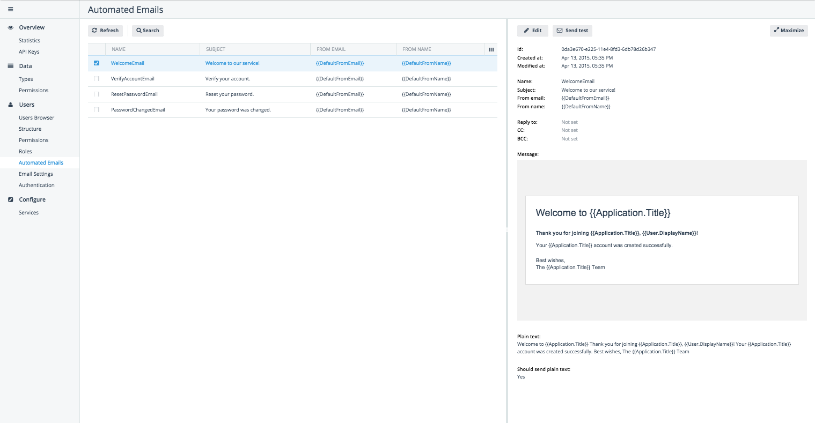
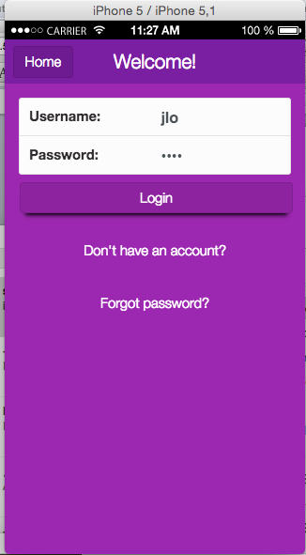
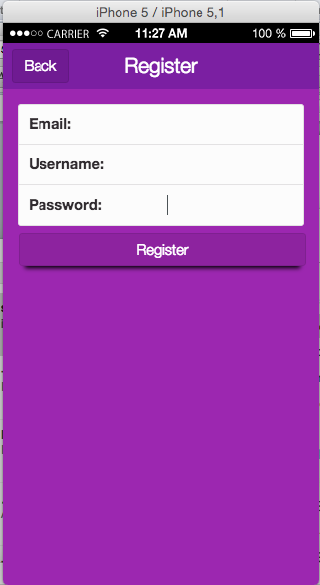
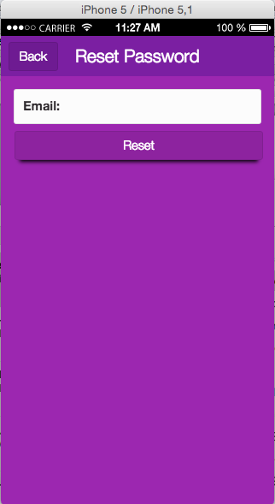
Login/Registration/Forgot Password
Works with email services automatically triggered to handle common user administration tasks (forgot password, welcome registration) in backend – all customizable in backend

Slide 52
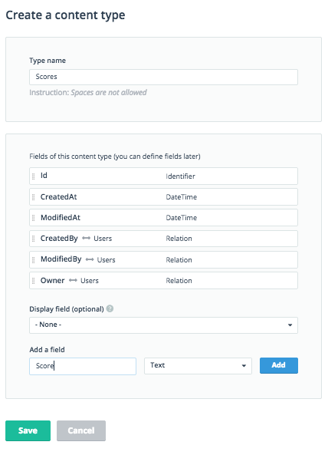
9. Add Scorekeeping capability
Save accuracy scores to backend when user clicks ‘done’
Create a datatype in the backend called ‘Scores’ with a field called ‘Score’ to store the data
var Scores = new kendo.data.DataSource({
type: "everlive",
transport: {
typeName: "Scores"
}
});
var apiKey = localStorage.getItem("apiKey");
var token = localStorage.getItem("token");
var el = new Everlive({
apiKey: apiKey,
url: '//api.everlive.com/v1/',
scheme: 'https',
token: token
});
Prep your code to pass the data

Slide 53
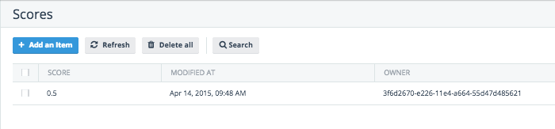
Start posting scores!
sendScore:function(e){
var score = localStorage.getItem("numCorrect")/localStorage.getItem("numAttempts")
//send to backend
var data = el.data('Scores');
data.get()
.then(function(data){
var data = el.data('Scores');
data.create({ 'Score': score},
function(data){
alert("Score saved!")
},
function(error){
alert(JSON.stringify(error));
});
});
}
It’s my score

Slide 54
Display your scores
var data = el.data('Scores');
data.get()
.then(function(data){
$("#score-list").kendoListView({
dataSource: Scores,
template: kendo.template($("#score- template").html()),
});
});
Grab the scores

Slide 55
Display your scores
<ul id="score-list" data-style="inset" data-role="listview" data-template="score-template"></ul>
<script id="score-template" type="text/x-kendo-template">
<li>
<div style="padding:5px">
#: kendo.toString(new Date(CreatedAt),'g')#
# if (typeof(Score) !== 'undefined') { #
Score - #: Score*100 #%
# } #
</div>
</li>
</script>
Show them on the frontend in a Kendo template

Slide 56
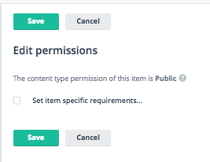
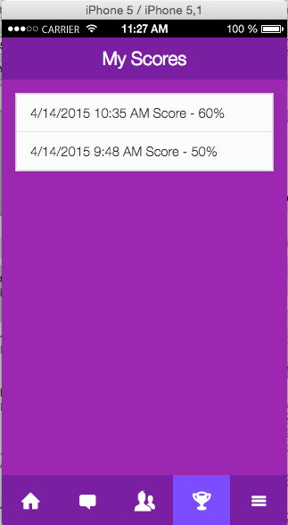
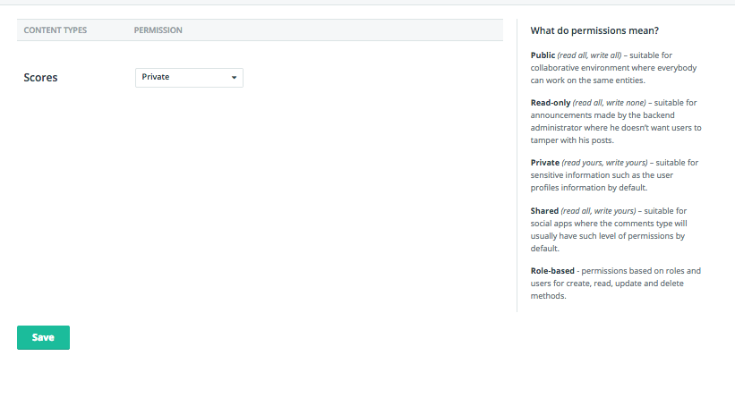
Voila!
This content type is public, so you see everyone’s scores. You can change this by setting it to private

Slide 57
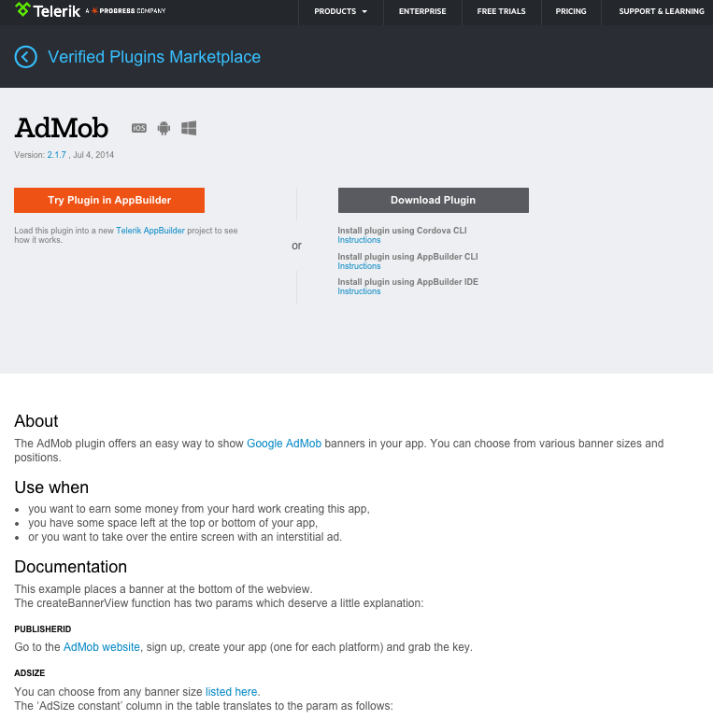
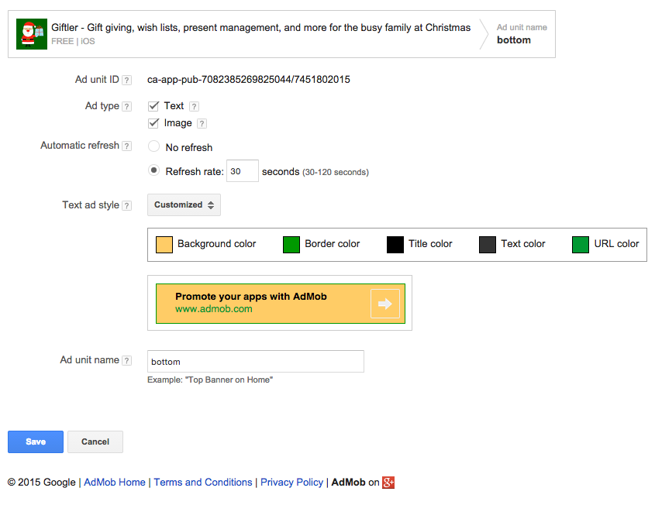

10. One more thing! Add a Plugin
Let’s add an AdMob ad
Set up an ad in AdMob
Add the AdMob Plugin from plugins.telerik.com
Add the ad to your view
Plugins!!!
A sample AdMob ad setup

Slide 58
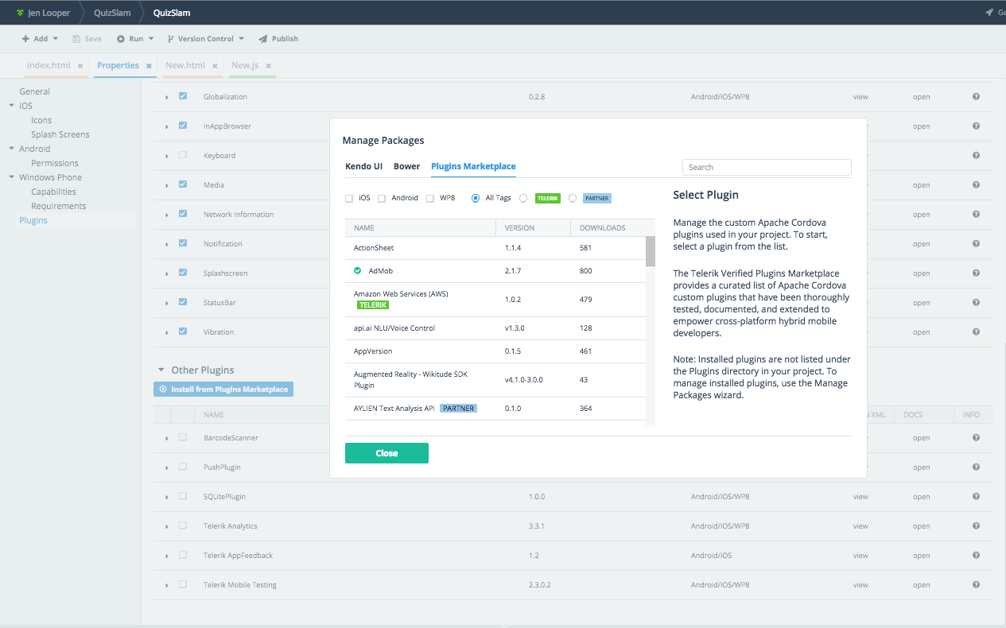
Add plugin via CLI
$ appbuilder plugin add "AdMob"
…or in browser

Slide 59


Deploy time!
Let’s move to the in-browser toolset. Migrate your codebase either by:
Committing it from your local to Github and bringing it into the Platform
Zipping your files and importing to Platform

Slide 60


View your app in companion app

Slide 61


Or in a built app
Load up your provisioning profiles for iOS here

Slide 62

Manage icons and splash screens

Slide 63



Install on your device
Here’s that ad

Slide 64

Finally, we have an app ready for production!
Publish from AppBuilder – send your app to the various stores

Slide 65

There is so much more in AppBuilder!
Ask Developer Relations
Ping me! @jenlooper
Read more on TDN (developer.telerik.com)
Visit the blogs (blogs.telerik.com)
Follow us on Twitter @Telerik
Sign up for an account at platform.telerik.com
It’s like an awesome smorgasbord!

Slide 66

Thank you! Now roll up your sleeves and start building!
No pressure!
Jen Looper
@jenlooper
Developer Advocate
Telerik Developer Relations Team
Evaluation: http://bit.ly/next-looper-1

